Slide 1



PROGRAMMING FOR DATA SCIENCE
P R E P A R E D F O R ( M A S H A L A L Q U D A H )
A M I R A T A L E B H 0 0 5 3 5 5 3 4
A F R A M E T A E B H 0 0 4 9 5 8 9 9
H A M D A A B D U L A Z I Z H 0 0 5 0 2 8 7 3
C R N : 2 4 1 3

Slide 2


PROJECT OVERVIEW
Dataset: UAE Used Car Prices
Aim: Identify what factors affect used car prices Tools: Python, Descriptive Analysis, Regression, Classification, Clustering

Slide 3









CLO1:PURPOSE OF DATA ANALYSIS
Understand how features like brand, mileage, and year influence price Help buyers find fair deals
Help sellers set competitive prices Improve platform recommendations

Slide 4

CLO1:MACHINE LEARNING ALGORITHMS
Regression → Predict car price
Classification → Predict categories (e.g., car condition or fuel type) Helps find patterns and give accurate predictions

Slide 5

Independent Variable
Dependent Variable
CLO1:VARIABLES
Brand / Model Mileage
Year
Fuel Type Transmission Condition (if available)
Price (selling price of the car)

Slide 6

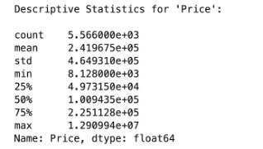


CLO2:DESCRIPTIVE STATISTICS FUNCTION

Slide 7



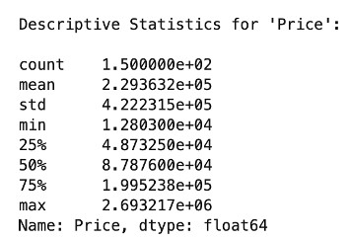

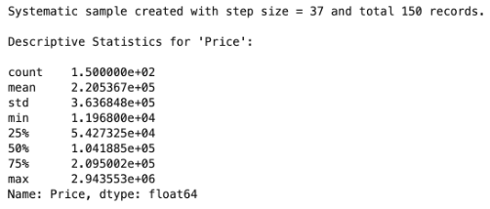
CLO2:SAMPLING
Random Sampling (150 samples)
Systematic Sampling

Slide 8



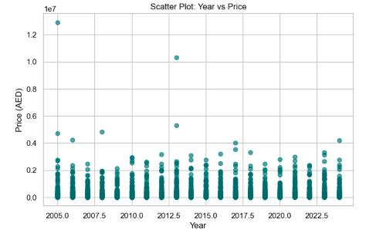
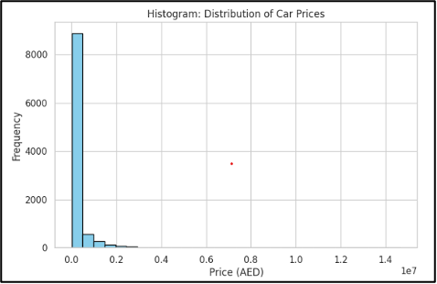
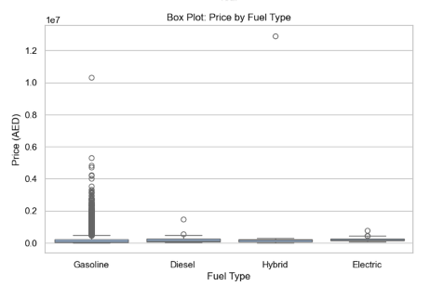
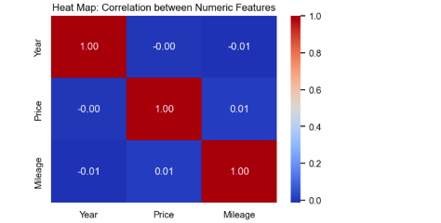
CLO2:VISUALIZATIONS
P A G E
0 8 / 1 5

Slide 9


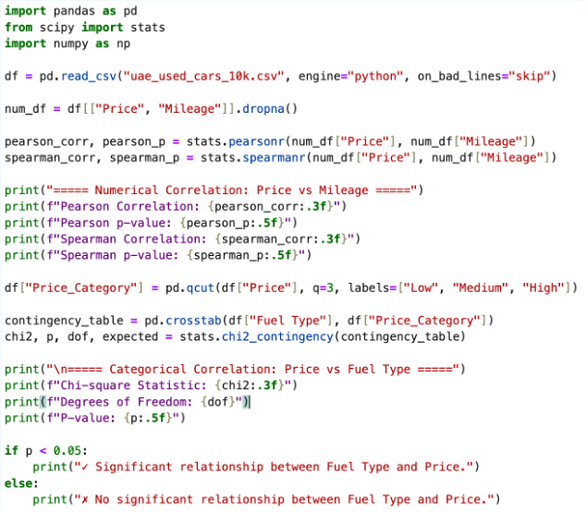
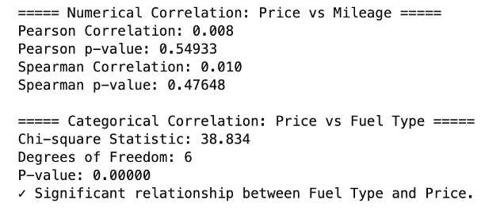
CLO2:HYPOTHESIS TEST
P A G E
0 8 / 1 5

Slide 10

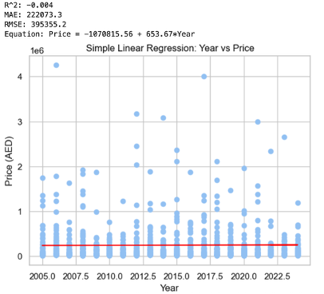
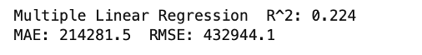
CLO3:REGRESSION MODELS
Simple Linear Regression
Multiple Linear Regression
P A G E
1 0 / 1 5

Slide 11

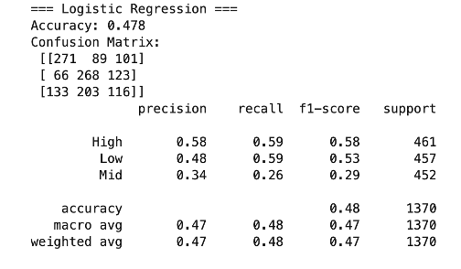
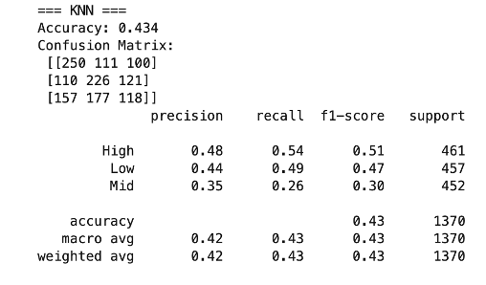
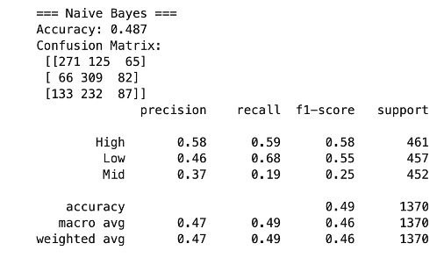
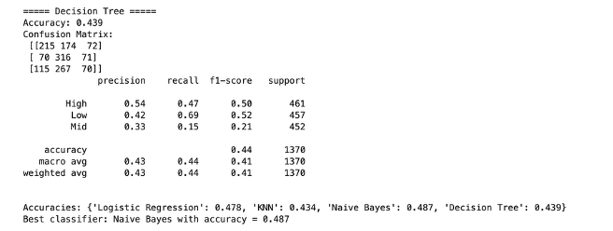
CLO3:CLASSIFICATION MODELS
P A G E
1 1 / 1 9

Slide 12

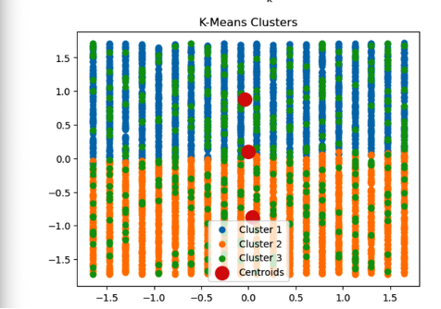
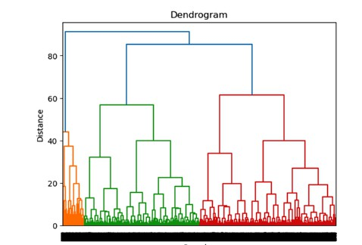
CLO3:CLUSTERING
K-means
Dendrogram (Hierarchical clustering)

Slide 13



STRATEGY TO IMPROVE THE SYSTEM
Replace Year with Age Add interaction features
Target encoding Remove outliers
Use Elbow s Silhouette Apply PCA

Slide 14



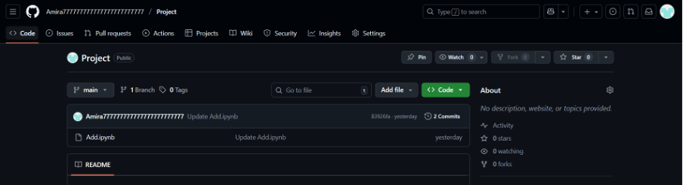

CLO4:GITHUB COLLABORATION
1. Create a GitHub Account

Slide 15
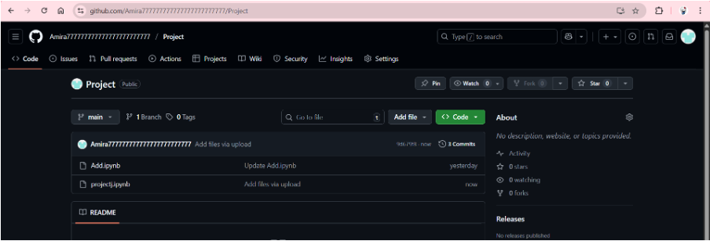
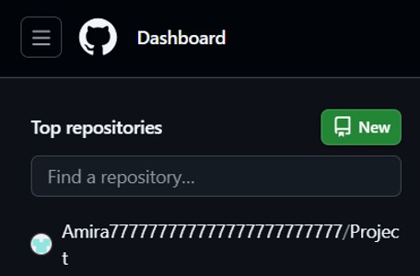
I created a new repository to organize all CLO1, CLO2, and CLO3 files.
Create a new repository

Slide 16
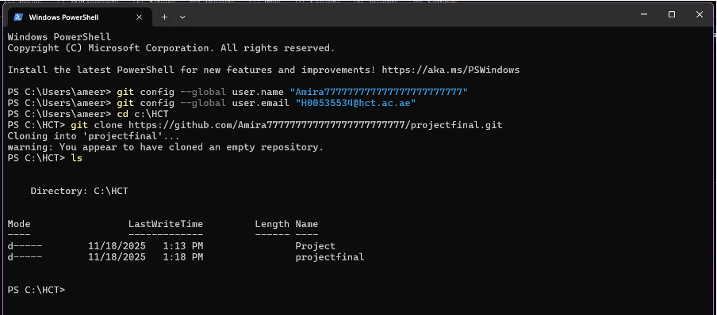
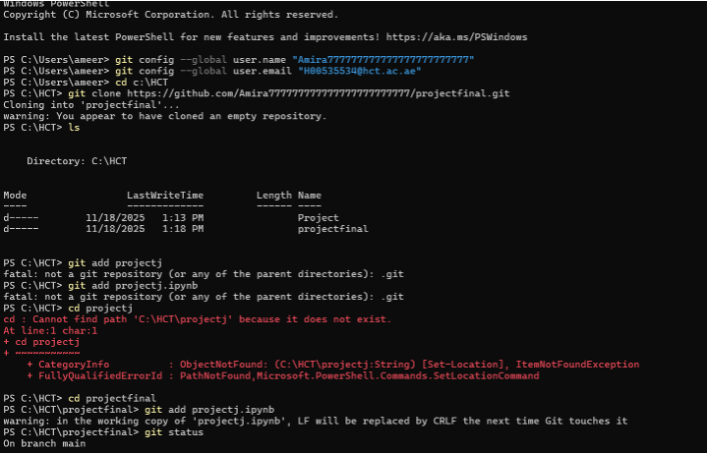
Configure Git with GitHub I connected Git to my GitHub account using username and email.
Clone the Repository
I cloned the GitHub repository to my local computer using git clone.
P A G E
1 6 / 1 9

Slide 17

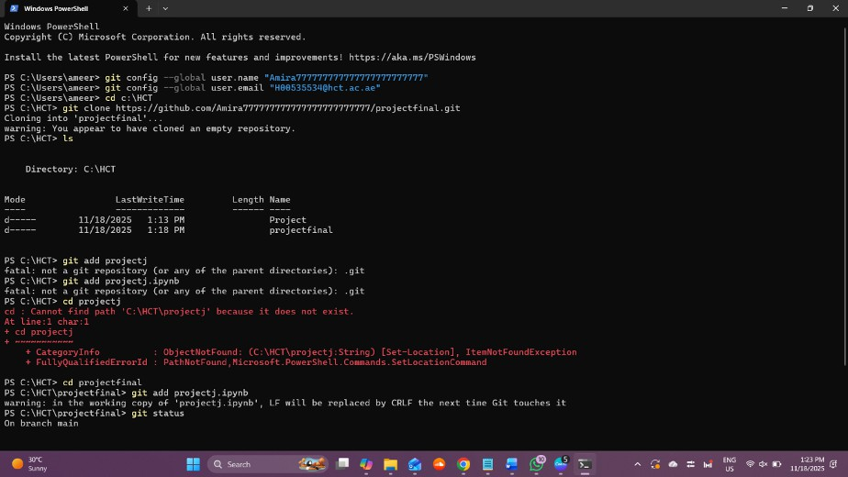
PULL FILES FROM GITHUB
P A G E
I used git pull to download updates from the GitHub repository

Slide 18

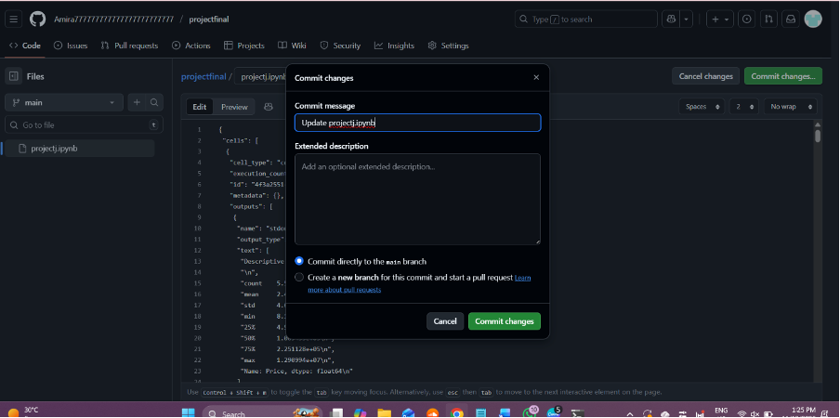
MODIFY & PUSH FILES BACK TO GITHUB
I edited one file, then used git add, git commit, and git push to upload the changes.

Slide 19



THANK YOU!
THIS CONCLUDES OUR PROJECT ON UAE USED CAR PRICE ANALYSIS.
I’M HAPPY TO TAKE ANY QUESTIONS.

